Slide 1
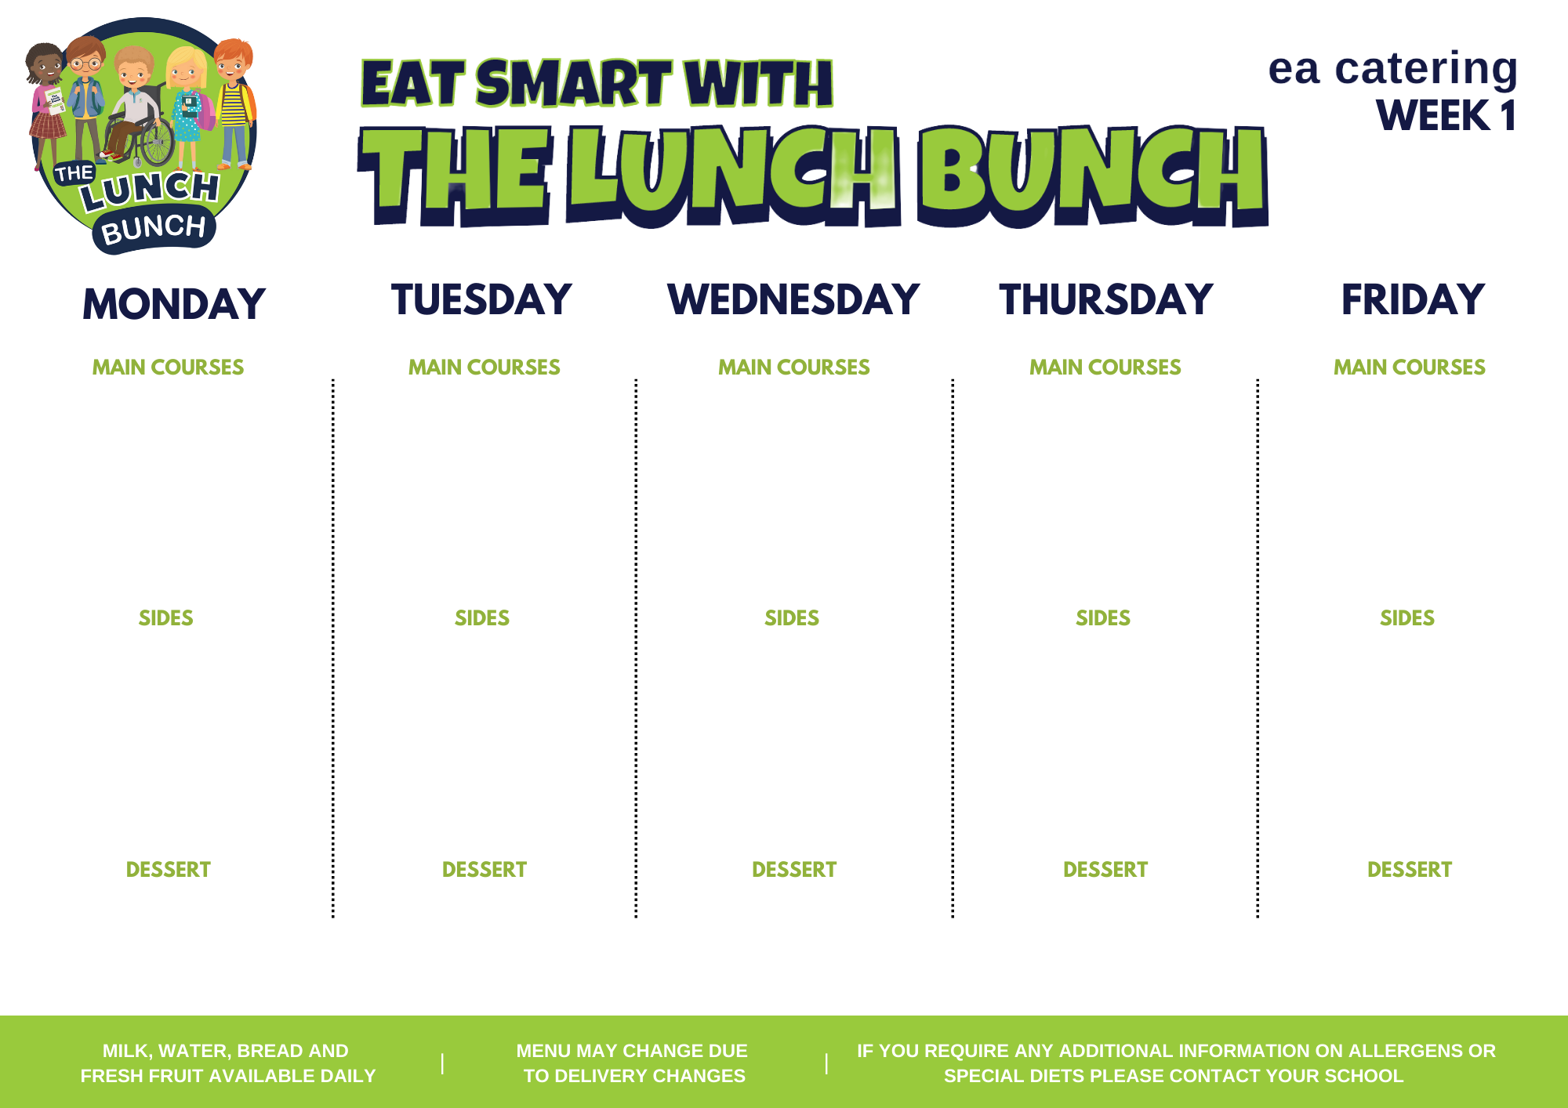
18 September
16 October
13 November
11 December
Spaghetti Bolognaise
Or
Crispy Cod Fishcake with Tomato Ketchup
Classic Margherita Pizza
Or
Italian Chicken & Tomato Pasta Bake & Garlic Bread
Lunch Bunch Chicken Curry & Naan Bread
Or
Chicken Panini & Coleslaw
Roast Chicken, Stuffing & Rich Gravy
Or
Beef Olive
Hot Dog
Or
Chicken Wrap & Sweet Chilli Sauce
Baton Carrots & Baked Beans
Mashed Potato, Salad
Garden Peas & Coleslaw
Chipped Potato, Pasta
Steamed Broccoli & Sweetcorn
Oven Roasted Potato Wedges, Rice
Baton Carrots & Cabbage
Mashed Potato or roast potato
Garden Peas & Spaghetti Hoops
Chipped Potato, Pasta
Homemade Ginger Biscuit & Custard
Strawberry Jelly, Ice Cream & Fruit
Banana Yoghurt Pot
Chocolate Sponge & Custard
Fresh Fruit & Yoghurt

Slide 2
28 August
25 September
23 October
20 November
18 December
Chicken Nuggets
Or
Homemade Lasagna
Spaghetti Bolognaise
Or
BBQ Chicken Pizza
Lunch Bunch Chicken Curry & Naan Bread
Or
Golden Crumbed Fish Fingers
Roast Turkey, Stuffing & Rich Gravy
Or
Salmon Fishcake
Sausages & Tomato Ketchup (on 1st Sept only)
Steakburger & Tomato Ketchup
(all other dates)
Or
Chicken Crumble
Steamed Broccoli & Garden Peas
Chipped Potato, Mashed Potato
Sweetcorn & Baked Beans
Diced Potatoes, Pasta, Salad
Garden Peas
Rice, Salad, Mashed Potato
Cauliflower & Baton Carrots
Mashed Potato or Oven Roast Potato
Sweetcorn & Salad
Or
Chipped Potato, Pasta
Ice Cream, Chocolate Sauce & Sliced Pears
Fruit & frozen strawberry mousse
Rice Krispie Square & Fruit
Fruit Muffin Slab
Flakemeal Biscuit & Fruit

Slide 3
04 September
02 October
30 October
27 November
Golden Crumbed Fish Fingers
Or
Mighty Mac ‘n’ Cheese with Garlic Bread Slice
Beef Meatballs with Italian Tomato & Basil Sauce
Or
Margherita Pizza
Lunch Bunch Chicken Curry & Naan Bread
Or
Bacon Slice
Roast Chicken, Stuffing & Rich Gravy
Or
Mexican Chilli with Nachos
Tasty Pork Sausages with Tomato Ketchup or Gravy
Or
Chicken Panini & Coleslaw
Baked Beans & Broccoli & Coleslaw
Mashed Potatoes
Garden Peas & Salad
Oven Baked Potato Wedges, Pasta
Mini Corn on the Cob
Steamed Rice, Chipped Potatoes
Baton Carrots & Tossed Salad
Mashed Potato or roast potato
Sweetcorn & Spaghetti Hoops
Chipped Potatoes & Mashed Potatoes
Artic Roll with Peaches
Shortbread, Milk Shake & Fruit
Strawberry Jelly & Fruit
Jam & Coconut Sponge & Custard
Melon Wedge

Slide 4
11 September
09 October
06 November
04 December
Beef Bolognaise with Garlic Bread
Golden Crumbed Fish Fingers
Or
Tex-Mex Enchilada
Lunch Bunch Chicken Curry & Naan Bread
Or
Steak Burger & Gravy
Roast of the Day, Stuffing & Rich Gravy
Or
Stuffed Chicken
Oven Baked Chicken Nuggets
Or
Admiral’s Ocean Pie
Or
Stuffed Bacon Roll/Bacon Slice
Garden Peas & Cabbage
Oven Baked Potato Wedges, Spaghetti
Mini Corn on the Cob & Spaghetti Hoops or Coleslaw
Chipped Potatoes, Pasta
Garden Beans & Sweetcorn
Mashed Potato, Rice
Cauliflower Cheese & Baton Carrots
Mashed Potato
Garden Peas & Baked Beans
Chipped Potatoes & Baked Potato
Chocolate Cake & Custard
Jelly & Mandarin Oranges
Cornflake Biscuit & Custard
Ice Cream with wafer & Fruit
Homemade Ginger Biscuit & Fruit

